Slide 1
Intro to Electrical Engineering
Day 1

Slide 2
What is electricity?
Where does electricity come from?
What do we use it for?
What else do we know about it?
Write down everything you know about electricity and circuits

Slide 3
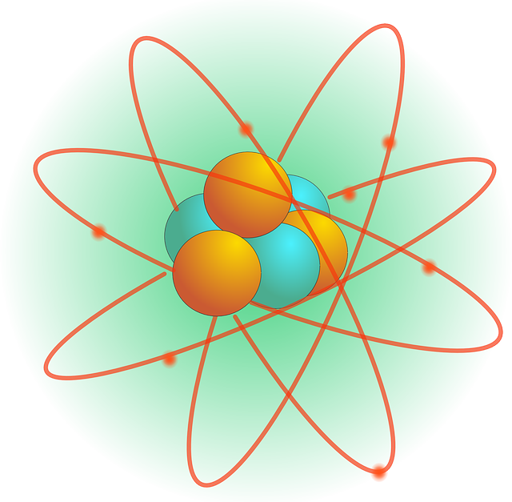
What is Electricity?
Everything is made up of atoms
Atoms are made up of smaller parts (protons, neutrons, and electrons)
Electrons have a negative charge
Electricity is caused by the movement of these negatively charged electrons

Slide 4
Conductors and Insulators
Conductors
Insulators
Materials that allow electrons to travel through them
Metals like copper, gold, & aluminum
Water
The human body
Materials that restrict the flow of electrons
Plastic
Rubber
Wood
Glass
Dry air
Can we think of any more examples?

Slide 5
What is an electric circuit?

